Slide 1
Brain Tumor 101
Presented by [NAME]
Notes:
Welcome to today’s meeting. This presentation is brought to you by the American Brain Tumor Association. If you’re here, you’re most likely dealing with a brand new situation that can be overwhelming. You, your spouse, your child, or someone very close to you has a brain tumor. During this presentation, called Brain Tumor 101, I hope to provide you a general background about brain tumor statistics, tumor types, symptoms, and treatment.
I’m [NAME] and [BACKGROUND].
Let’s get started.

Slide 2
Brain Tumor Impact in the United States
More than 79,000 new cases of primary brain tumors will be diagnosed this year
More than 4,800 children between the ages of 0 – 19 will be diagnosed with a brain tumor this year
Brain and central nervous system tumors are the most common cancers among children 0 – 14
Almost 700,000 people in the U.S. are living with a primary brain or central nervous system tumor
This year, nearly 17,000 people will lose their battle with a brain tumor
More than 100 types of brain tumors exist
Information provided by the CBTRUS http://www.cbtrus.org/factsheet/factsheet.html
Notes:
As you can tell from the others here today and the statistics on this page, you are not alone.
Here are some facts about the prevalence of brain tumors and types in the United States.
[Read bullets from page]

Slide 3
Brain Tumors Defined
Notes:
I just mentioned that there are more than 100 types of brain tumors. However, all brain tumors have some factors in common. Let‘s start by defining what a brain tumor is, and common terms you might hear that describe brain tumors.

Slide 4
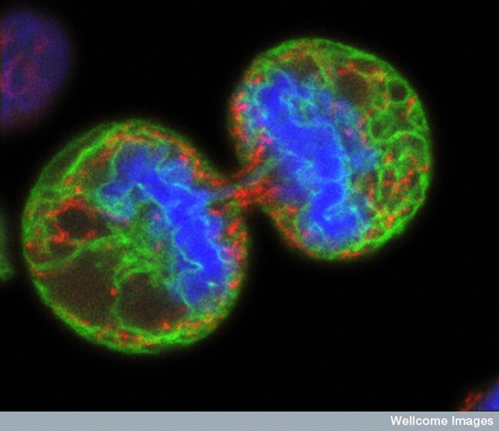
What is a brain tumor?
A collection of abnormal cells that grows in the brain or central spine canal
One abnormal cell becomes two, two becomes four, four becomes eight, until there is a lump of abnormal cells
Notes:
Our brains, along with the rest of our body, are made up of cells. In a typical adult body, new cells only form to replace old or damaged ones. In children, new cells form to help children grow and develop.
Sometimes, a collection of abnormal cells begins to multiply where they are not needed. One abnormal cell becomes two, two become four, four becomes eight, and they develop into a lump of cells.
When this lump of cells grows in the brain or the central spine canal, it is called a brain tumor.

Slide 5
How do tumors form?
Research is still trying to determine
Multiple insults to the cell?
One big hit?
Compromised immune system?
Cell-to-cell communications?
Notes:
Cells begin to multiply out of control when normal cells acquire an error – usually called a mutation – in their DNA. Researchers are examining a number of factors that could contribute to the causes of cell mutation. Some of these factors are highlighted here.
There may be multiple insults – or injuries – to the cell from physical trauma, radiation, or carcinogens.
Perhaps a single traumatic hit damaged the cell and caused the abnormality.
A compromised immune system may allow mutated cells to continue living and growing.
Cell-to-cell communication may also play a role. Cells in our bodies talk to each other through chemical signals. Although scientists are still learning about this, it is possible that some of these chemical signals may damage a cell’s DNA.

Slide 6
Other terms
Tumor
Other terms
Neoplasm
Lesion
Space occupying mass
Notes:
The lump of abnormal cells is most commonly called a tumor. Other words used to describe tumors are neoplasm, lesion, or space occupying mass. A neoplasm can be benign or malignant (or cancerous). We’ll talk more about cancerous vs. non- cancerous tumors when we discuss the different types of brain tumors.

Slide 7
Common signs and symptoms of a brain tumor
unusual headaches
seizure(s)
memory, personality, or behavior changes
inability to process incoming information correctly
visual changes: blurred vision, double vision
change in motor control
Notes:
You or your loved one most likely experienced one or more of these symptoms before being diagnosed with a brain tumor.
Common symptoms include:
Unusual or new headaches
One or more seizures, which can simply be an involuntary movement of an extremity or a blanked-out look where the person remains conscious. On the other hand, the person may have a generalized seizure with full body shaking, falling to the ground, and the person is unconscious.
Some people experience memory, personality, or behavioral changes. These symptoms are often seen by their loved ones first.
Other people may develop blurred vision or double vision.
And they may have change in motor control, like difficulty controlling movement

Slide 8
Symptoms – correspond to tumor location and size & type of tumor
Notes:
Let’s take a quick look at the brain.
Symptoms are often related to the location of the tumor. As in the illustration, different parts of the brain have unique functions. The frontal lobe controls thoughts and reasoning, and primary movement. The parietal lobe regulates sensation, sensory perception and spatial relationships. The temporal lobe controls behavior, memory, emotion, and hearing and vision pathways. The cerebellum controls balance. The brain stem has many connections to and from the spinal cord to the brain. In fact, there are many connections all over the brain.
The tumor location can affect the specific function of that part of the brain where it is located.

Slide 9
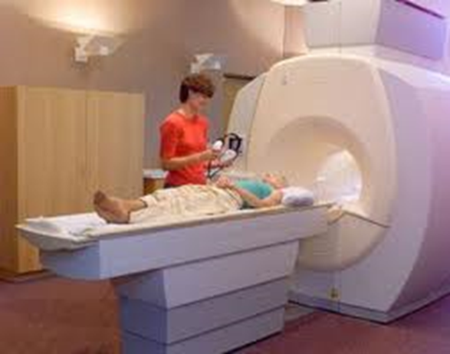
How brain tumors are diagnosed - MRI
MRI scanning remains the gold standard
CT scan for emergencies, then MRI
Notes:
To determine whether or not a patient with these symptoms has a brain tumor, and to get more information about the tumor, an MRI with a contrast dye remains the gold standard for brain tumor diagnosis. If a person is taken to the emergency room for neurological symptoms, a CT scan is commonly the first test done. If a brain tumor is suspected from the results of the CT Scan, usually the doctor will then order an MRI.

Slide 10
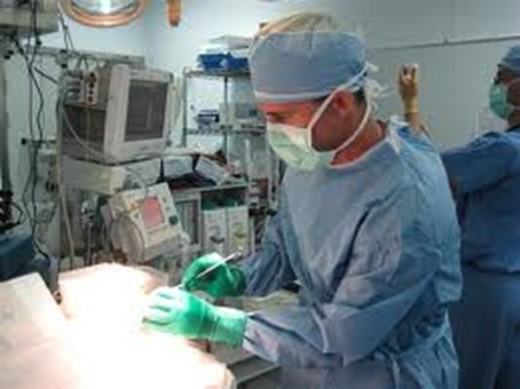
Diagnosis continued…
Surgery/tissue samples still most reliable method
Biomarkers in tissue and bodily fluids are being used to confirm diagnosis
Notes:
Once a brain tumor has been identified, tissue samples of the brain tumor are the most reliable method of diagnosis to determine the nature of the abnormality.
After the tumor’s cells are removed, a pathologist is able to examine the cell types under a microscope.
In addition, your doctor may perform other tests that will provide data about the genomic characteristics of the tumor. These are called biomarkers, and can be found in the abnormal cells themselves, or sometimes in the blood and other bodily fluids as well. Biomarker analysis is needed to determine the type of tumor and plan a course for treatment.

Slide 11
Two broad categories of brain tumors
Primary Brain Tumors in U.S.
begin in the brain, tend to stay in the brain
incidence = nearly 79,000 diagnosed annually
4,800 are children
Prevalence = nearly 700,000 people
“benign versus malignant” and everything between
Metastatic Brain Tumors in the U.S.
begin as a cancer elsewhere which spreads to the brain
always malignant
Notes:
Tumors are generally divided into two broad categories.
Brain tumors are either primary or metastatic in nature. The main difference is where the tumor originates.
Primary brain tumors begin in the brain, and tend to stay in the brain. As previously stated, nearly 70,000 brain tumors are diagnosed annually, and about 4,600 of these cases are in children. Nearly 700,000 people are living with a primary brain tumor. Primary brain tumors may be benign – meaning they are not cancerous – or they may be malignant (or cancerous). Some tumors are “in between” and cannot easily be classified as benign or malignant.
Metastatic tumors begin as a cancer somewhere else in the body and spread to the brain. They are almost always malignant.

Slide 12
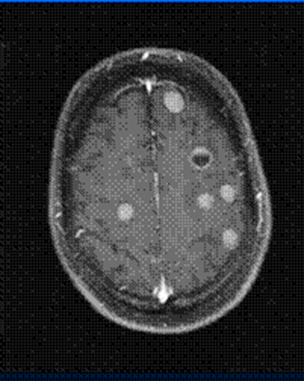
Imaging - Primary and Metastatic
Notes:
Here are MRI Scans of primary and metastatic brain tumors. About two thirds of patients with metastatic brain tumors have more than one tumor.

Slide 13
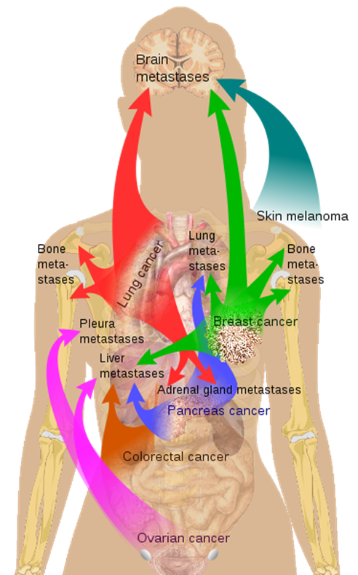
Metastatic brain tumors
“Type” = the site of the primary cancer
Single or multiple tumors
Patients tend to receive
treatment for metastatic brain
tumor by oncologist who treated
primary site, or a neuro-
oncologist who specializes
in brain tumors.
Notes:
Metastatic tumors are considered an extension of the tumor from the primary cancer site, such as breast, lung, or skin. A person may have just one tumor, but as previously stated, two thirds of the time, there will be more than one tumor. Metastatic tumors are commonly treated by the medical oncologist who has been treating the cancer at the primary site. Neuro-oncologists – doctors who specialize in brain tumors – can also be consulted.

Slide 14
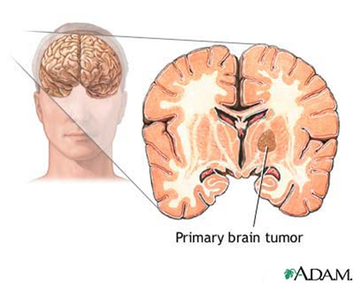
Primary brain tumors
Begin in the brain
Over 100 types
“Type” determined by cell type; classification changing to biologic differences
The biology provides clues as to why some people do better than others
Central Brain Tumor Registry of the United States (CBTRUS) tracks the
incidence of brain
tumors
Notes:
Primary brain tumors start in the brain. The type of tumor is determined by what type of cell the tumor is made of. For example, an astrocytoma tumor is made of mutated astrocyte cells. Classification is changing based upon the biology of the tumor, including the biomarkers we discussed before. The Central Brain Tumor Registry is the organization that tracks the statistics of primary brain tumors.

Slide 15
Is it cancer?
Primary tumors:
Benign versus Malignant
Notes:
Benign brain tumors are considered noncancerous. They are slow growing. Even if a tumor is benign, the tumor can affect function depending on its location. A malignant tumor is faster growing and invades the brain.

Slide 16
Tumor grading
International grading system by WHO
Graded I – IV
Grade I – least malignant, slow growth
Grade II – slow growing, but can spread, some recurrence
Grade III – faster growing, “malignant,” often recurrence
Grade IV – fastest, most aggressive
Tumor may contain several “grades” of cells at once
Notes:
Tumors are given a “grade” – one through four – to help your care team plan treatment. The grade levels are part of an international system put in place by the World Health Organization. The tumors are graded according to their malignancy.
Grade I tumors are the least malignant and are usually associated with long-term survival. They grow slowly, and can often be effectively removed by surgery.
Grade II tumors are relatively slow-growing and can spread into nearby normal tissue. They can recur, sometimes as a higher-grade tumor.
Grade III tumors are considered malignant. The cells of a grade III tumor are more actively reproducing and grow into nearby brain tissue. These tumors tend to recur.
Grade IV tumors are the most malignant. They reproduce rapidly, and may even form new blood vessels to fuel their rapid growth.
Within the tumor there may be different “grades” of cells. Some cells may be growing more slowly while others are growing rapidly. The tumor is graded based on the most malignant cells detected.

Slide 17
Most common primary brain tumors
Meningioma
Gliomas
Low Grade Astrocytoma
Malignant Astrocytoma
Glioblastoma
Oligodendroglioma
Medulloblastoma, Ependymoma, Pilocytic Astrocytoma (more common in children)
Notes:
The most common tumor types include meningioma and glioma, which includes low grade astrocytoma, malignant astrocytoma, glioblastoma and oligodendroglioma. The next most common tumors include medulloblastoma, ependymoma and pilocytic astrocytoma. These tumors are more common in children.
I’ll go into more detail about these common tumor types.

Slide 18
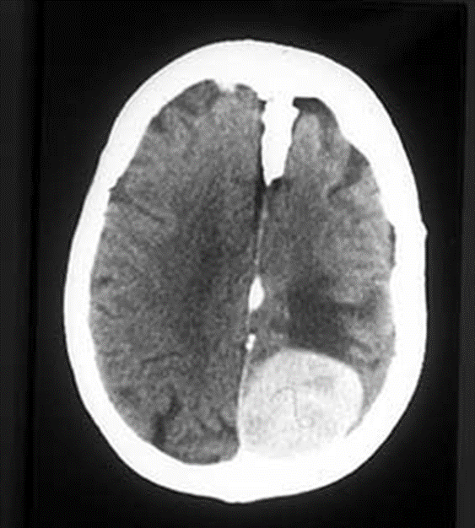
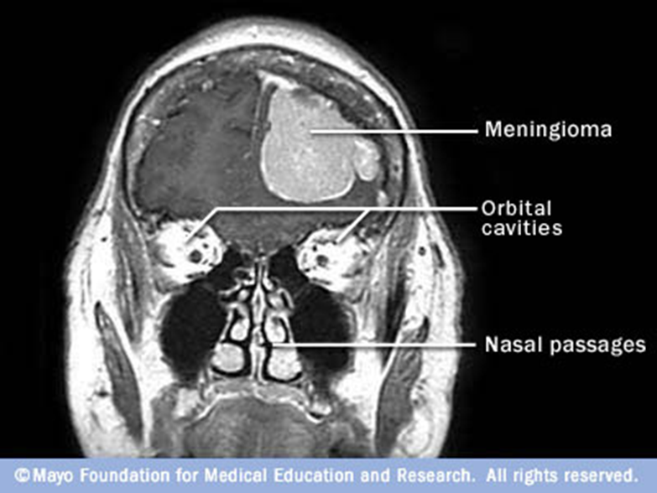
Meningioma
Most common type of primary tumor Arises from the meninges = the lining of the brain
Google Images, www.student.bmj.com (Left is right, right is left, bone is bright white)
Notes:
The meningioma arises from the meninges, the covering of the brain.
The picture on the left shows the tumor, the large white spot in the lower right-hand section of the brain. The meningioma is labeled on the right. Most of the time, meningiomas are not actually invading the brain, they are just pushing on the brain.
Meningiomas are commonly slow growing and may not recur if the tumor is completely removed. A person can have neurological impairment if the meningioma is pushing on a functional area. For example, if the tumor is pushing on the optic nerves, there could be vision loss.

Slide 19
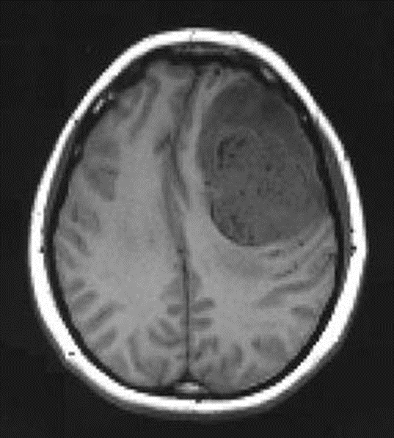
Malignant Glioma
Gliomas arise from the glial, or “gluey,” parts of the brain
Different types of gliomas = astrocytomas, oligodendrogliomas, mixed gliomas
(Left is right, right is left, bone is bright white, malignant tumor with contrast dye is grey) Midline shift, Google Images, http://www.ispub.com/xml/journals/ija/vol8n2/pregnant-fig1.jpg
Notes:
Gliomas arise from the glial cells which surround the nerve cells in the brain. They are the most numerous cells in the central nervous system.
Malignant primary brain tumors, such as a glioblastomas, typically grow faster than benign tumors, and aggressively invade surrounding tissue.
There are many different types of glial cells, so many of the names of gliomas refer to the types of cells affected.
For example, astocytomas develop in the glial cells called astrocytes, which form connective tissue in the brain.
Oligodendrogliomas develop in the oligodendrocytes, which are glial cells that make up the brain’s supportive tissue.
A mixed glioma is made up of more than one type of glial cell; however, with new technologies, doctors are now able to more accurately diagnose these tumors as either astro- or oligodenroglioma, so this diagnosis is becoming more rare.

Slide 20
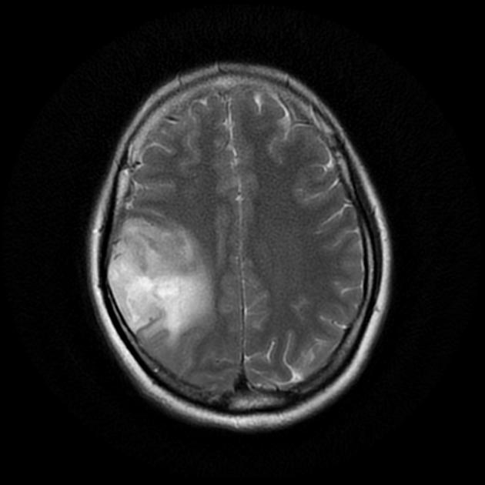
Anaplastic Astrocytoma
High grade tumor, pre-treatment (Left is right, right is left)
http://radiopaedia.org/cases/anaplastic-astrocytoma-who-grade-iii
Notes:
Here is a picture of an Anaplastic Astrocytoma, a type of glioma. It is also called a grade III astrocytoma, or a grade III malignant astrocytoma.

Slide 21
Glioblastoma
Notes:
Here is a picture of a Glioblastoma, the most aggressive type of glioma. It is also known as a grade IV astrocytoma.

Slide 22
Who is Most Affected by Brain Tumors?
Brain tumors do not discriminate
But, different tumor types at different ages
Notes:
Brain tumors do not discriminate between people of color, or socio economic status, and have only a little difference between males and females. Younger adults tend to have low-grade tumors, and older adults will more likely have malignant tumors.

Slide 23
Common tumors by age
Notes:
This graph shows the types of tumors in children aged 0 to 19. Gliomas other than pilocytic astrocytomas are the most common tumor type. Pilocytic astrocytomas the next most common as seen on the blue line, followed by medulloblastomas.

Slide 24
Common tumors by age continued…
Notes:
This graph shows tumor age groups form 20 to 75+years. The incidence for meningioma rises as people grow older. Glioblastomas also rise in frequency with older age. Oligodendrogliomas, vestibular schwannomas and oligoastrocytoma frequencies remain largely the same over the years.

Slide 25
How are brain tumors treated?
Surgery to remove tumor bulk
Radiation to disable cell reproduction/shrink the tumor
Chemotherapy to either kill tumor cells or interfere with their growth
Notes:
The most common treatment for brain tumors include surgery, radiation therapy and chemotherapy. Surgery is used to remove as much of the tumor as possible without causing neurological harm. Radiation is used to disable cell reproduction and shrink the tumor. Chemotherapy is used to kill tumor cells or interfere with their growth.

Slide 26
Where are new treatments headed?
Neuronavigation setup with VarioGuide™, courtesy BrainLab
Notes:
In addition to these traditional therapies, new treatments are always being researched.

Slide 27
Where new treatments are headed cont.
Enhanced tumor cell visibility/visualizing single cells live imaging and treatment during surgery
Highly focused radiation, radiation enhancers
Targeted drug therapies, “Repurposed” drugs
Low intensity, intermediate frequency, alternating electric fields that disrupt cell growth
Immune system enhancing drugs
Combination diagnostics and therapeutics
Biomarkers
Notes:
As medical technology advances, it’s opening up more options for treatment.
For example, better imaging during surgery leads to greater brain tumor visibility for the neurosurgeon and greater chances for more accurate tumor removal.
Radiation oncologists have been experimenting with different types of radiation and radiation enhancers.
Neuro oncologists are working with targeted drug therapies and drugs used for other purposes to be tried for brain tumors.
They have also been using alternating electrical fields that disrupt cell growth,
And trying new immune system enhancing drugs.
And, as we’ve mentioned before, researchers continue to seek answers about tumors through identifying DNA biomarkers in blood and other fluids.
We are in a very active and exciting time of brain tumor research.

Slide 28
Prognosis
Definition: Prediction of how long someone may live with a tumor
Benign tumors = greatest predictor of survival is extent of tumor removal/likelihood of recurrence, long term survival impacted by QOL
Malignant tumors = greatest predictor is age (< 45), amount of tumor removed, type of tumor/biologic activity, functional status
Why may one GBM be different than the next? general health/co-morbidities and location
Notes:
A person with a brain tumor is given a diagnosis and treatment plan, along with a prognosis.
A prognosis is the prediction of how long someone may live with the tumor.
If the tumor is benign, the prognosis is based on how much of the tumor is removed. The more the tumor is removed, the better prognosis. A person may live a long time with a benign tumor, but if it is located in an area that controls functions such as speech, vision, movement or memory, it can impact quality of life.
For malignant brain tumors, poorer survival is associated with age greater than 45 years, the amount of tumor removed, and tumor type.
Not all brain tumors of the same type respond to treatment the same way. Every tumor has its own genomic make up even if it has the same name (e.g., Glioblastoma). If someone has other illnesses or is poorly functioning, the survival time may be shortened. Tumor location also affects survival.

Slide 29
Effects on patients with Malignant Tumors
neurocognition –
slower processing
poor attention
short term memory
lack of abstract thinking ability
changes in personality/judgment
fatigue
headaches
left/right, up/down confusion
visual changes/lack of depth perception
Notes:
Many changes can occur due to the tumor or treatment. These are some of the symptoms. They often impact the patient’s ability to function as before.
[Read bullets]

Slide 30
Effects on patients with Benign Tumors
“But you look fine to me”
fatigue
math, reading challenges
short term memory issues
employment/job related challenges
balance, walking challenges
personality/mood changes
Notes:
Patients diagnosed with benign tumors have similar problems to patients with malignant tumors. Unfortunately, these problems can cause changes in many aspects of one’s life.
[read bullets]

Slide 31
Effects on the family
change of traditional roles
single parenting in a two parent household
loss of relationships as they existed
caregiving/caretaking/safety responsibilities
fear of seizures
fear of personality/behavior changes
fear of the unknown
fear of the future
“care of the caregiver” takes second or third place
Notes:
All of these aspects are very important. Having a brain tumor is a family disease because it affects everyone.
[read bullets]

Slide 32
Recap
Tumors that begin in the brain are called ____________ brain tumors.
What is the annual incidence of brain tumors?
Name two common types of brain tumors.
What is the most common type of primary brain tumor?
How are brain tumors diagnosed? Treated?
What are some of the effects of a brain tumor?
Notes:
To recap, we’ve gone through the basics about brain tumors today.
We’ve explored major types of tumors, as well as specific types. We’ve talked about diagnosis, treatment and some of the effects of brain tumors.
Obviously, there is a lot more to know about brain tumors.

Slide 33
Contact information
Phone: 1-800-886-ABTA (2282)
Email: abtacares@abta.org
Online: www.abta.org
www.facebook.com/theABTA
www.twitter.com/theABTA
Notes:
The American Brain Tumor Association is here to help you through your brain tumor journey. You can call the ABTA CareLine or find more information on their website at any time of the day or night.
Thank you for joining me today.

