Slide 1
Brain Tumors: Cognitive and Emotional Symptoms and Side Effects
Presented by [NAME]
Notes:
Welcome to today’s meeting. The content in this presentation is from the American Brain Tumor Association. Today, we’re going to talk about how brain tumors affect a person’s cognition and memory, as well as their emotional responses and even personality.
I’m [NAME] and [BACKGROUND].
Let’s get started.

Slide 2
Overview of cognitive/emotional symptoms
Affects more than half (50%) of patients with malignant brain tumors
Causes
From the tumor itself: symptoms based on tumor size/location
From treatment: Fatigue, nausea, memory loss
Permanent or temporary?
Difficult to talk about
Stigma/embarrassment
“Normal” for care team
Notes:
It’s estimated that more than half of patients with a malignant brain tumor will experience some kind of cognitive or personality change. (1)
Just as with physical symptoms, emotional and cognitive symptoms can be caused by a brain tumor. With a limited amount of space in the skull, the growth of anything can affect a patient’s pain levels and ability to function. For example, a tumor pressing on the optic nerve can affect a patient’s vision.
In addition, tumor treatment can cause additional physical side effects such as fatigue, nausea, or short-term memory loss.
Most people want to know whether their symptoms are permanent or temporary. The answer varies based on a wide range of factors that include age, tumor type, tumor location, rate of growth, and the success of treatment and follow-up. Some symptoms may be gone as soon as the tumor is gone – others can continue for months or years following treatment.
It’s important to take note of all these non-physical symptoms and report them to your care team. Some may be so minor that they go undetected. Other times, the caregiver recognizes that something is different, even when the patient does not.
It can be hard to talk about these symptoms because they may seem not seem as important as the physical symptoms. Patients and their caregivers often feel frustrated, defensive and embarrassed about their reduced abilities.
However, these changes will often be perceived by your care team as common. And while there isn’t usually one single solution to these issues, there are medications, exercises, therapies and support groups to help you manage cognitive and emotional issues.
(1) http://www.abta.org/brain-tumor-information/symptoms/mood-swings.html

Slide 3
Common tumor symptoms
Notes:
I’m going to start with some common tumor symptoms.

Slide 4
Symptoms – correspond to tumor location and size & type of tumor
Notes:
Let’s take a quick look at the brain. As you know, symptoms are often related to the location of the tumor.
A tumor in the frontal lobe will affect movement. One in the parietal lobe may cause the patient to have changes in sensory perception, etc.

Slide 5
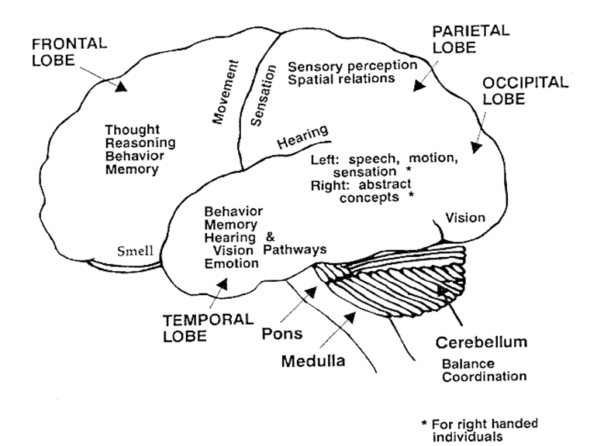
Frontal tumors
Mood, problem solving
Short-term memory
Notes:
Let’s look more closely at a tumor located in the frontal lobe.
A tumor in this area can cause not just physical changes, but emotional changes as well.
In addition to movement, activities such as reasoning, behavior, memory, personality, judgment, inhibition and mood are controlled by this part of the brain. A tumor and/or treatment in this area can make it difficult to find the right word in a conversation or recall recent memories. In many patients, long-term memory stays intact.
Some examples of mood changes include a normally polite person suddenly becoming rude, or a quiet person becoming less inhibited or disruptive.

Slide 6
Parietal tumors
Left/right confusion
Language/arithmetic
Notes:
A tumor in the parietal lobe can affect abilities in reading and math. A man who had not been diagnosed with a tumor in the parietal lobe woke up one day to find that he could not read the newspaper. Another patient, who had always taken care of the family finances, lost the ability to calculate the tip at a restaurant.

Slide 7
Other causes of changes
Tumor treatments
Emotional trauma (“I have brain tumor!”)
Fatigue
Medications
Notes:
In addition to the location, size and growth rate of the tumor, other factors may cause cognitive or psychological changes.
Treatments such as radiation, surgery, and chemotherapy can also affect how the patient feels and acts. Tumor removal can also damage surrounding tissue, causing cognitive changes.
The emotional trauma of being diagnosed with a brain tumor is important to consider as well. Any type of major trauma, such as this, can cause anxiety and depression.
Fatigue, a common side-effect, can also effect patients’ cognitive abilities. Major fatigue can deplete the energy required for thinking and remembering.
Certain medications, even over-the-counter prescriptions, can affect cognitive ability. It is important to review possible side effects of medications with your doctor.

Slide 8
Types of neuropsychological changes
Emotional/personality
Depression, anxiety, obsessive-compulsive
Mood swings, behavioral changes
Learning/memory
Short-term memory loss
Difficulty processing information
Attention/concentration
Confusion, difficulty planning
Executive functioning
Irrationality
Impaired judgement
Notes:
Medical professionals usually group symptoms together to help direct treatment. Here are some types of cognitive and psychological symptoms:
First is emotional and personality. The patient may develop psychiatric symptoms such as depression, anxiety, or obsessive-compulsive behaviors. He or she may also have mood swings, exhibit frequent irritability, display socially inappropriate behavior, or deny that he or she has any behavioral problems at all. For example, a typically easy-going person may suddenly have outbursts of rudeness or anger.
Another type of change is learning and memory. Some patients may show difficulty processing, storing and retrieving information, or may have short-term memory loss. A patient might ask what’s for dinner, and then ask again several more times a few minutes later as if asking a new question. Typically, short-term memory loss occurs more frequently than long-term memory loss.
Attention and concentration is another type of change. This might be exhibited by confusion, frequent distraction, and difficulty planning.
Executive functioning refers to decision making based on facts. An impairment of this type shows up as unreasonableness or irrationality. A patient might make poor decisions or show a lack of judgement.

Slide 9
Depression
Signs
Feelings of sadness or unhappiness
Irritability or frustration, even over small matters
Loss of interest or pleasure in normal activities
Reduced sex drive
Insomnia or excessive sleeping
Changes in appetite
Agitation or restlessness
Indecisiveness, distractibility and decreased concentration
Fatigue
Frequent thoughts of death, dying or suicide
Crying spells for no apparent reason
Unexplained physical problems, such as back pain or headaches
Notes:
We briefly mentioned depression as one of the possible effects of a brain tumor diagnosis and treatment. I wanted to talk about it a little more in-depth because it affects both patients and their caregivers.
Many people are uncomfortable with the idea of depression as an illness, preferring to believe it is something that you can “snap out of” if only you try. It is not. Depression is a serious clinical condition with several different causes. It can be caused by a change in the brain’s chemical neurotransmitters, which control mood; changes in hormone levels, which can trigger depression when out of balance; genetic predisposition; physical changes to the brain, such as a brain tumor; and major life events, such as a brain tumor diagnosis. The good news is that once diagnosed, depression can usually be effectively treated.
This is a long but partial list of some of the signs of depression. While everyone can feel these feelings sometimes, it is the persistence and intensity of these signs that will signal that help is needed.

Slide 10
MANAGING COGNITIVE EFFECTS
Notes:
Now, let’s talk about some of the help available.
Each patient is unique, and these cognitive and psychological changes may be temporary or long-term. They can also change over time. Fortunately, there are options for coping with and managing these symptoms. None of them is a magic bullet, but you can put together solutions and set goals that are realistic for the patient and caregiver.

Slide 11
Difficulties and solutions
Overstimulation
Identify sources
Take a break
Memory loss
Calendars/organizers/checklists
Routines
Aggression
Notes:
Here are a few examples of some difficulties you or the patient you care for might experience and how to handle these situations.
Overstimulation happens when patients get overwhelmed in situations where there are too many sights and sounds. To help, they can identify and remove the sources of distraction, like a TV or radio in the background, or they can take a break in a quiet place when needed.
Memory loss, even if it’s mild, can cause depression and anxiety in brain tumor patients. People may withdraw at the exact time when they need to feel less alone. Learning techniques and using tools to remain independent can help greatly. Calendars, organizers and checklists can help, as can making and sticking to routines.
Aggression is an occasional symptom that can cause injury to the patient and even the caregiver. It’s important to pay attention to levels of aggression – which can come and go – and talk to your doctor about this problem. Immediate solutions include creating a calm environment by reducing noise and excess movement.

Slide 12
Professional treatment options
Speech and language therapy
Cognitive rehabilitation therapy
Talk therapy
Medication
Notes:
In addition to practicing techniques at home, plenty of professional help is available for neuropsychological issues.
Just as patients strengthen their bodies through physical therapy, cognitive functioning can be improved by rebuilding neuropathways in the brain with a variety of methods. These include:
[READ FROM LIST]
Let’s look at these in more detail.

Slide 13
Speech and language therapy
Specialist: speech-language pathologist
Initial testing
Physical exam
Spoken exam
Treatment
Exercises/activities
New techniques
Notes:
When patients have difficulty with speech, language, or the ability to eat and swallow, speech and language therapy can help.
The first step is to bring up these concerns to your doctor, who may recommend a speech-language pathologist, also called a speech therapist. The speech-language pathologist will likely perform a number of tests to determine the type of services you need.
Tests include a physical examination that may include an evaluation of the face, mouth and tongue movements. If you have swallowing problems the therapist may recommend a video fluoroscopy or modified barium swallow study.
You will also be given a series of spoken tests, such as naming common objects, engaging in a conversation, understanding and using words and answering questions about something you just read or heard. You might also answer yes-no questions, respond to open-ended questions, tell a story or explain a joke or phrase.
Treatment will be tailored toward activities that meet your needs and help you compensate for any difficulties you are having. For example, if you have trouble swallowing, you might learn new eating techniques such as positioning your food differently. Using gestures, drawings or flash cards might help you express yourself better.
These activities can help patients increase lip and tongue movement, improve listening skills or help patients find new ways to express their thoughts, all leading to a better quality of life while dealing with the effects of the brain tumor.

Slide 14
Cognitive rehabilitation therapy
Retrains the brain
Specialist: “CRT”
Initial evaluation
Interview
Questionnaire, observation
Treatment
Reestablish/develop new cognitive skills
Geared towards day-to-day independence
Notes:
Cognitive rehabilitation therapy helps retrain the brain to perform necessary skills. You might also hear terms like cognitive retraining, memory retraining, cognitive rehabilitation, brain injury rehabilitation, problem solving therapy and brain therapy.
A cognitive rehabilitation therapist, or CRT, is a physical, occupational or other type of therapist who specializes in helping patients regain cognitive function after a brain injury or trauma such as tumor treatment and surgery.
Just like in speech therapy, patients will undergo an evaluation to determine what services they need. The evaluation often includes an interview along with questions and an observation to gain an understanding of how the patient manages in everyday situations.
Therapy focuses on retraining the brain to use cognitive skills in order to reestablish already-learned patterns of behavior, or establishing new ways – actually developing new neural pathways – to compensate for the parts of the brain that have been damaged.
The therapist designs a treatment plan that is very practical to help patients function better in their day-to-day life and gradually increase self-reliance and self-confidence.

Slide 15
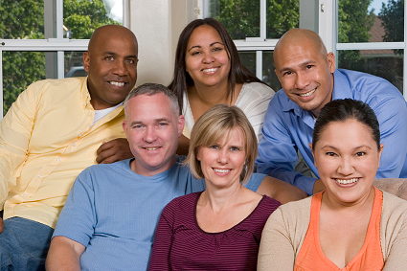
Psychotherapy/talk therapy
Depression affects up to 40%
Specialists:
Psychiatrist, psychologist
Neuropsychologist
Social worker
Support groups
Local
Online
Notes:
Clinical depression is a common side effect^{i}, affecting up to 40% of patients with a brain tumor^{ii}, even those who have never shown signs of depression in the past.
There are many specialists who can help with depression, including psychiatrists and psychologists.
In addition, neuropsychologists practice a sub-specialty of clinical psychology, specializing in the relationship between the brain, thinking, and behavior. A neuropsychologist has expertise in assessing and treating problems of cognitive skills, psychological functions and behavior, as they relate to the brain and central nervous system.
Finally, most hospitals and brain tumor clinics have social workers available to patients. These professionals have an understanding of the everyday and existential issues that people with brain tumors and their families experience.
Support groups are also an important tool for dealing with depression. Meeting and talking with others in the same situation as yourself can help you feel less isolated. Support groups can be found through your hospital or clinic or the ABTA website. Support can also be found on ABTA Connections, an online support community.
http://link.springer.com/article/10.1007/s11060-009-9825-4
http://link.springer.com/article/10.1023/A:1015728825642

Slide 16
Medication
Help with depression, concentration/attention
Prescribers
Doctor/primary physician
Neuro-oncologist
Psychiatrist
Neuropsychiatrist
Notes:
Anti-depressant medication and other types of medication can help lessen the effects of depression and, in some cases, attention and concentration issues.
These can be prescribed by a number of specialists, including:
Your primary physician
Neuro-oncologist
Psychiatrist
Neuropsychiatrist

Slide 17
Managing cognitive/psychological symptoms
Wide variety of physical symptoms
Type, severity of tumor
Management by
Keeping a log
Talking to care team
Bring up the topic
Well known/understood by care team
Patient isn’t “crazy”
Treatments can help
Notes:
Just as with physical side effects, cognitive and psychological symptoms vary widely depending on the type of tumor and its severity, the type of treatment and the effect of the diagnosis on the patient and family.
It’s helpful to keep a log of all symptoms. You’ll be able to help your care team better provide answers if you can provide more details about the symptoms or side effects you’re experiencing.
Although they can sometimes be difficult to discuss, a discussion about psychological and cognitive changes is a big relief for most patients and their families. Patients realize they aren’t “going crazy” and there are concrete steps that can help patients work around or improve some of the problems. The changes are a common side effect of brain tumors, and your care team will be well aware of them.

Slide 18
Contact information
Phone: 1-800-886-ABTA (2282)
Email: abtacares@abta.org
Online: www.abta.org
www.facebook.com/theABTA
www.twitter.com/theABTA
Notes:
We encourage you to call the ABTA CareLine or find information on our website.
Thank you for joining me today.

